Slide 1
Angular
Angular != AngularJS

Slide 2
Angular vs AngularJS
Angular 2, 4, 5 +
Angular 1.x
Complete Rewrite of JS
Component Based
Type Script
More of a structured language
Compiles into Java Script
Not Just a SPA
Java Script Like
Controllers and Directives
“Phasing out $scope but still needed in Directives”
In need of a re design
There is No advantage to knowing AngularJS if you want to learn Angular. In fact it may be easier to learn Angular if you don’t know AngularJS. (AngularJS is still a valid tool and will be around for a while but I would not recommend its use for new projects. Easier to learn Angular then learn how to maintain old JS code if necessary.)

Slide 3
Angular is constantly being improved
Six Month Release Cycles
Versions
2 – Complete rewrite of Angular.
Not backward compatible. Although can be intermixed (they say)
3 – There was no Version 3
4 – Skipped to Ver 4 to keep in “sync” with Router Release
New Routing. Old being deprecated.
Concept of Form Models now “Reactive Forms” (name change)
5 – New HTTP Module
Actually available in Ver 4.3.
Old versions still supported for now

Slide 4
Forget about SPAs
Angular is a framework used to create applications.
Angular code can be used / reused for any deployment target: web, mobile web, native mobile and native desktop.
Lazy loading allows modules to be loaded on demand to support larger applications.

Slide 5
How does Angular work? (there is a bunch of stuff that has to happen to make your code work)
Basic startup code is available that will spin up the Angular application.
Bootstrap – loading of the Angular startup code and main module.
Similar to the MS MVC dll that is run by IIS and the code supported by Visual Studio. The MVC Developer doesn’t need to worry about how VS loads the page.
Once basic “bootstrapping” had been done you create Modules.
Modules can be loaded on demand via Lazy Loading.

Slide 6
What do I need and Why do I Need it?
Text Editor
You need something to create the Angular Type Script files and HTML templates.
We are currently using Visual Studio Code or Visual Studio.
A “Means” to compile Type Script Files, run a Dev Server and get the Angular Source Code (sorry NuGet is not supported)
Node JS
Visual Studio

Slide 7
What is the best way to build an Angular SPA (today)
Today was included because this can change.
Options
Angular CLI
Includes built in optimization in the compile in addition to command line short cuts.
Requires Node.js for dev
Angular Quick Start
Easily integrated with Visual Studio (if desired) or will require Node.js if not put into Visual Studio for type script compile and dev server.
Optimization is manual
May not be available anymore
Angular “Visual Studio 2015 Quick Start”
Uses Quick Start with VS. Need to optimize.
Visual Studio 2015 with Angular CLI
Can be done.
Visual Studio 2017 Template
Works but did not appear to support latest version of Angular so concerns about MS keeping up to date
Start typing and code it all yourself

Slide 8
Angular CLI
ng new
Creates basic file structure and main module
Loades Node Modules
ng serve
Complies Typescript and spins up dev server
Refreshes when files are modified
Web Pack
Optimizes code for deployment
Many other features

Slide 9
So How do I do it?
Go to https://angular.io/
See all the advantages of Angular
Click “Get Started” which takes us to https://angular.io/guide/quickstart
Follow the Directions…

Slide 10
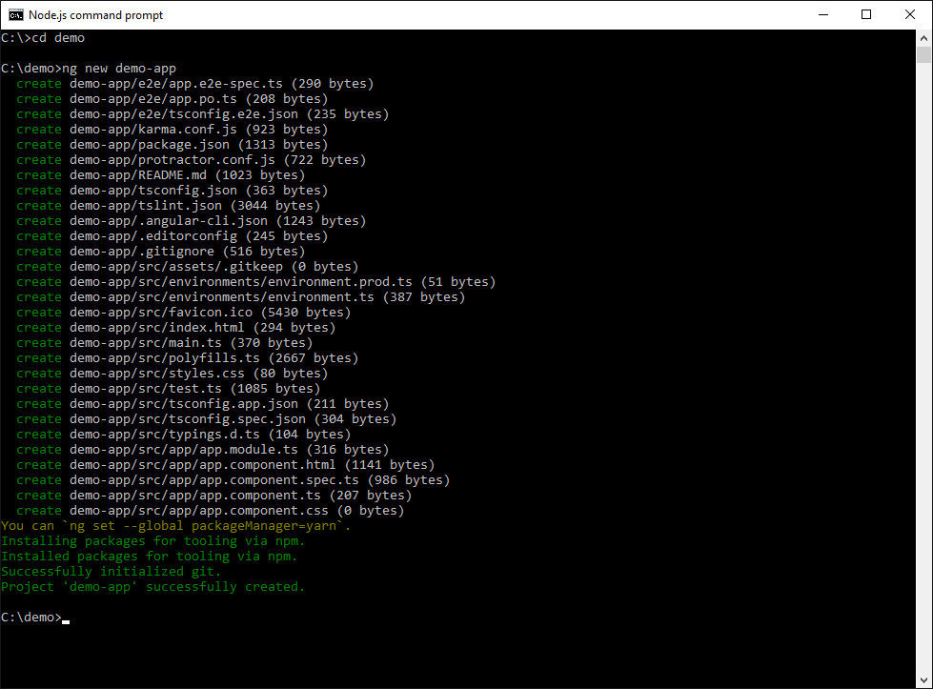
ng new demp-app (output) – because you won’t want to wait 3 min…

Slide 11
Live Demo
Open code in Visual Studio Code https://code.visualstudio.com/
ng serve (compile TS and run dev server)
Localhost:4200
Check out code
If time permits look at Trialnet Diary

